Slide 1
PROJECT TITLE
CAPSTONE PROJECT
Student Name : MIHIR KUMAR
College Name & Department : PGDAV COLLEGE ,
BSC(H)COMPUTER SCIENCE

Slide 2
OUTLINE
Problem Statement
Technology used
Wow factor
End users
Result
Conclusion
Git-hub Link
Future scope

Slide 3
Problem Statement
Secure communication is crucial in the digital era. Traditional encryption methods attract attention, making them vulnerable to attacks. Steganography offers a discreet way to hide messages within images. Our project implements a password-protected image steganography system, ensuring secure message concealment and extraction while maintaining data privacy. With a user-friendly interface, it provides a reliable solution for confidential communication in sensitive environments.

Slide 4
Technology used
Programming Language: Python
Image Processing Library: OpenCV
Data Handling: NumPy
User Interface: Streamlit
Security: SHA-256 hashing for password protection
These technologies ensure secure, efficient, and user-friendly encryption and decryption processes.

Slide 5
Wow factors
Password-Protected Encryption: Ensures only authorized users can retrieve the hidden message.
Invisible Data Hiding: No noticeable distortion in images.
Streamlit-Based UI: Simple and interactive design for easy encryption/decryption.
Secure Verification: Messages can only be retrieved using the correct password.
Low Image Distortion: Ensures the image remains visually unchanged while embedding data.

Slide 6
End users
This system is beneficial for:
Cybersecurity Enthusiasts: Learning about secure communication methods.
Government & Intelligence Agencies: Secret data transmission.
Journalists & Whistleblowers: Safe communication without detection.
Individuals Needing Privacy: Personal data protection.
It provides a secure way to share sensitive information without raising suspicion.

Slide 7
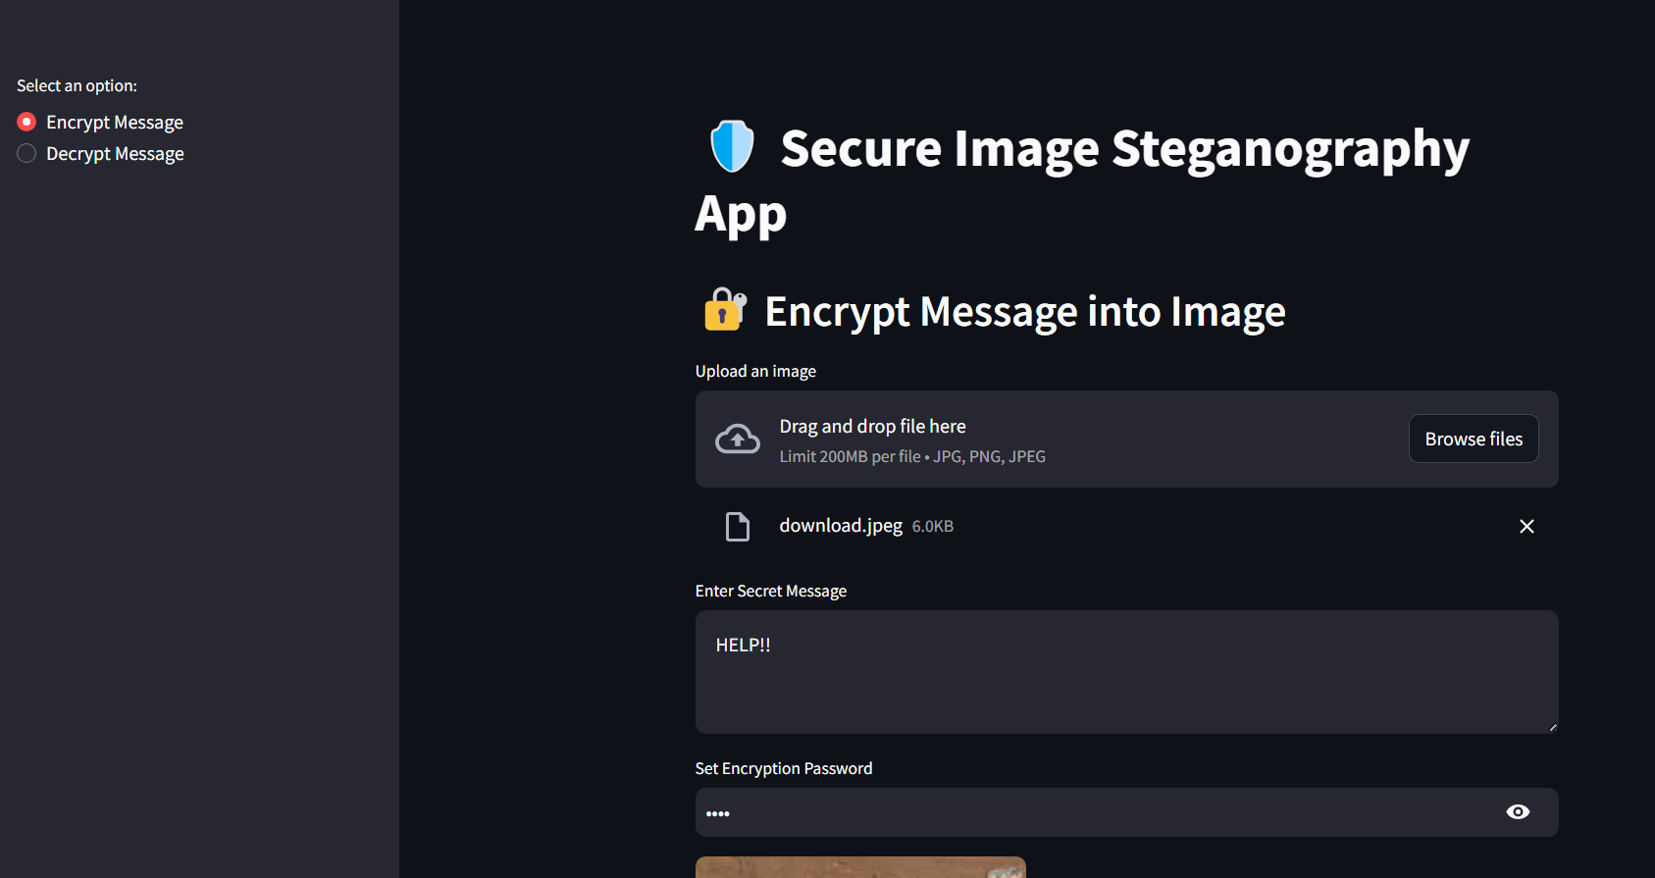
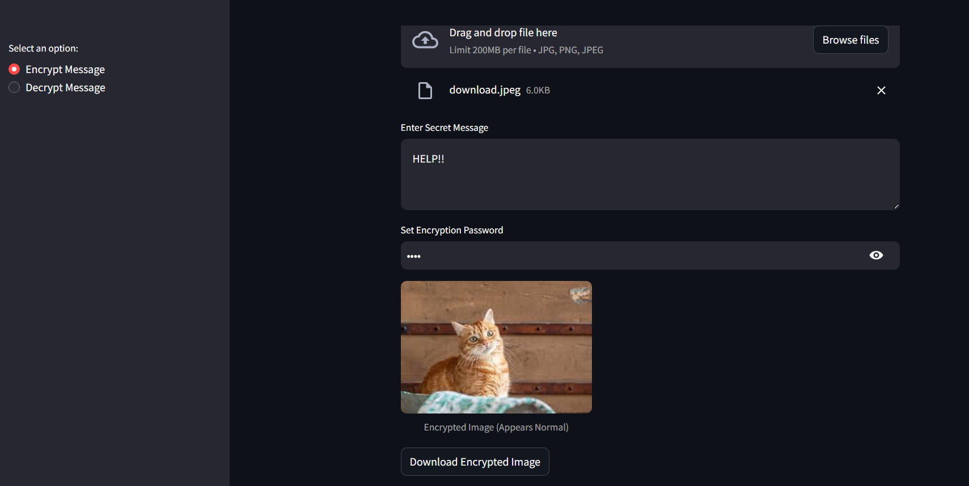
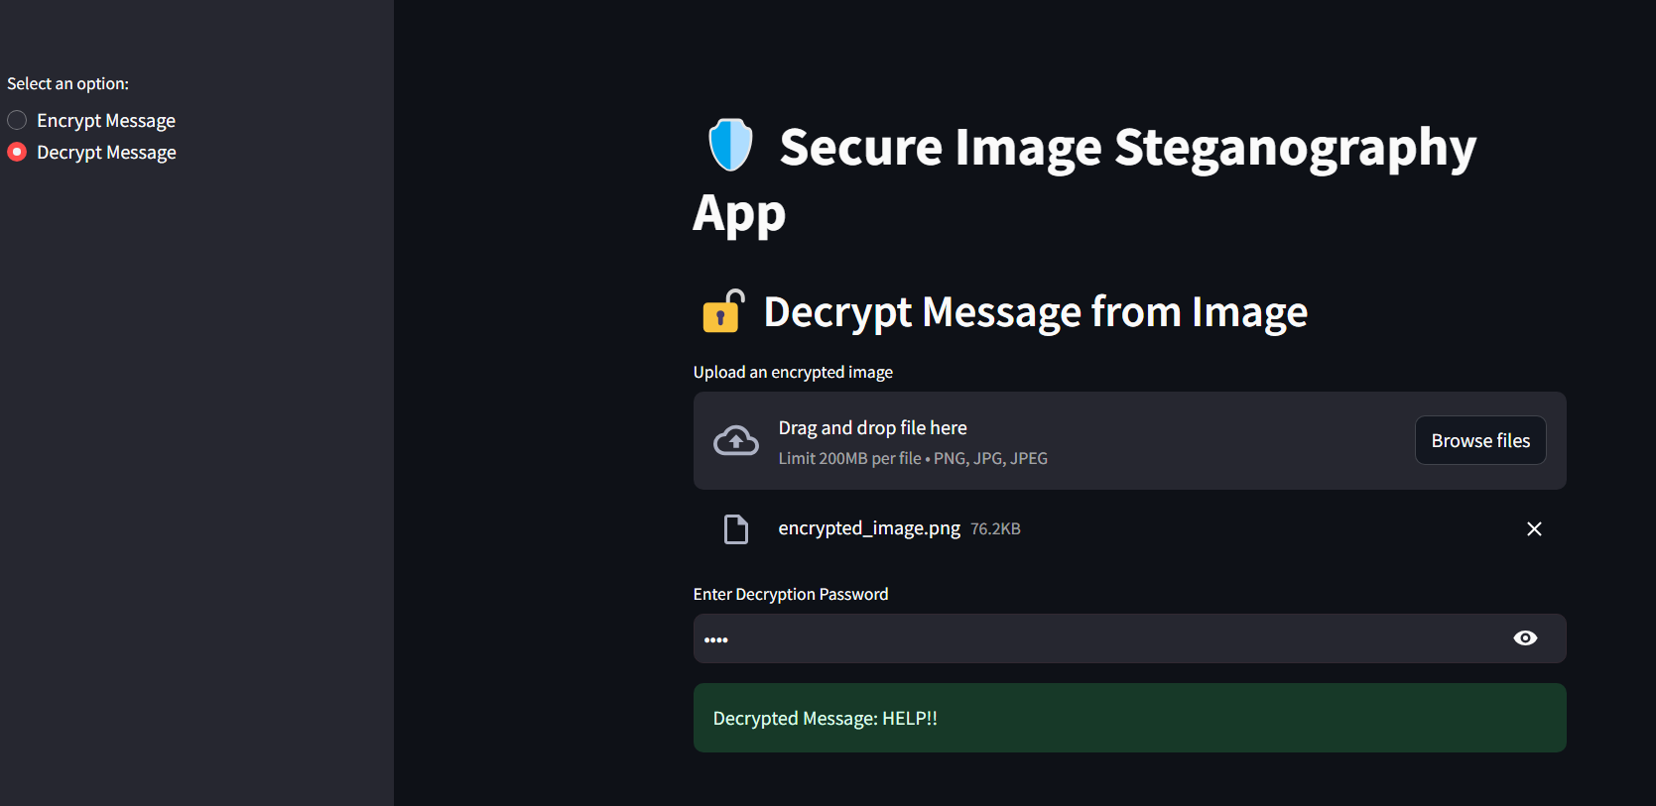
Results

Slide 8
Conclusion
This project successfully implements secure image-based data hiding using steganography. With password-protected encryption, it adds an extra layer of security, ensuring only authorized users can access the hidden message. The system is designed to be user-friendly, lightweight, and efficient, making it useful for individuals and organizations needing secure, private communication. This approach enhances traditional encryption methods by making messages undetectable.

Slide 9
GitHub Link
🔗 GitHub : https://github.com/mihir-krs/Steganography-App-Aicte-Internship-Cybersecurity-Edunet-Foundation

Slide 10
Future scope(optional)
To further improve the system, we plan to:
Expand to Other File Types: Support for text, audio, and video steganography.
Enhance Security: AI-powered steganalysis resistance.
Cloud Integration: Secure encrypted storage and sharing.
Mobile App Development: A lightweight mobile version for easy access.
These enhancements will improve usability and expand real-world applications.

Slide 11
THANK YOU

